Slide 1
FINANCIAL DATA ANALYSIS

Slide 2
INTRODUCTION
The Financial Data Analysis Project aims to deliver an in- depth examination of our organization’s financial performance through a comprehensive and interactive Power BI dashboard. This project is designed to provide stakeholders with real-time insights into key financial metrics, KIP’s, supporting data-driven decision-making processes and strategic planning.

Slide 3
Problem Statement
Analyzing the competition, it is difficult for a business to survive. This data set has information on the market capitalization of the top 500 companies in India. Serial Number Name Name of Company Mar Cap – Crore Market Capitalization in Crores Sales Qtr – Crore Quarterly Sale in crores. Find key metrics and factors and show the meaningful relationships between attributes.

Slide 4
IMPORTANT STEPS
1. Collect and Integrate Data
Data Collection: Gather financial data from identified sources.
Data Analysis: Utilizing Power BI’s analytical tools to perform detailed financial analysis and visualization.
Data Integration: Combine the collected data into a central repository, ensuring it is clean and transformed as needed
2.. Data Cleaning: Used Python to clean data and prepare my financial data. This may involve removing duplicates ,blanks, renaming columns or formatting data types.
3. Open Power BI Desktop: Launched Power BI Desktop on my computer.
4. Connect to Data: I clicked on get Data and selected my data source (e.g., Excel file, CSV file) where my Financial data is stored. Imported my Financial data and Load the data into Power BI.
5.Data Visualization: Creation of interactive and visually appealing dashboards that facilitate data exploration.
6.Build Reports: Develop detailed reports for different financial metrics (e.g., revenue, expenses, cash flow).
7.User Interface Design: Design the dashboard interface to be user-friendly and intuitive.

Slide 5
KPI’S
Top 5 Industries By Market Capital
Top 5 Company Sales Quarterly
Sum of Large Cap Industries, Sum of Medium Cap Industries and Sum of Small Cap Industries
Total Market Cap and Total Qtr Sales by Total Industries Name.
Total Monthly Sales and Total Qtr Sales

Slide 6
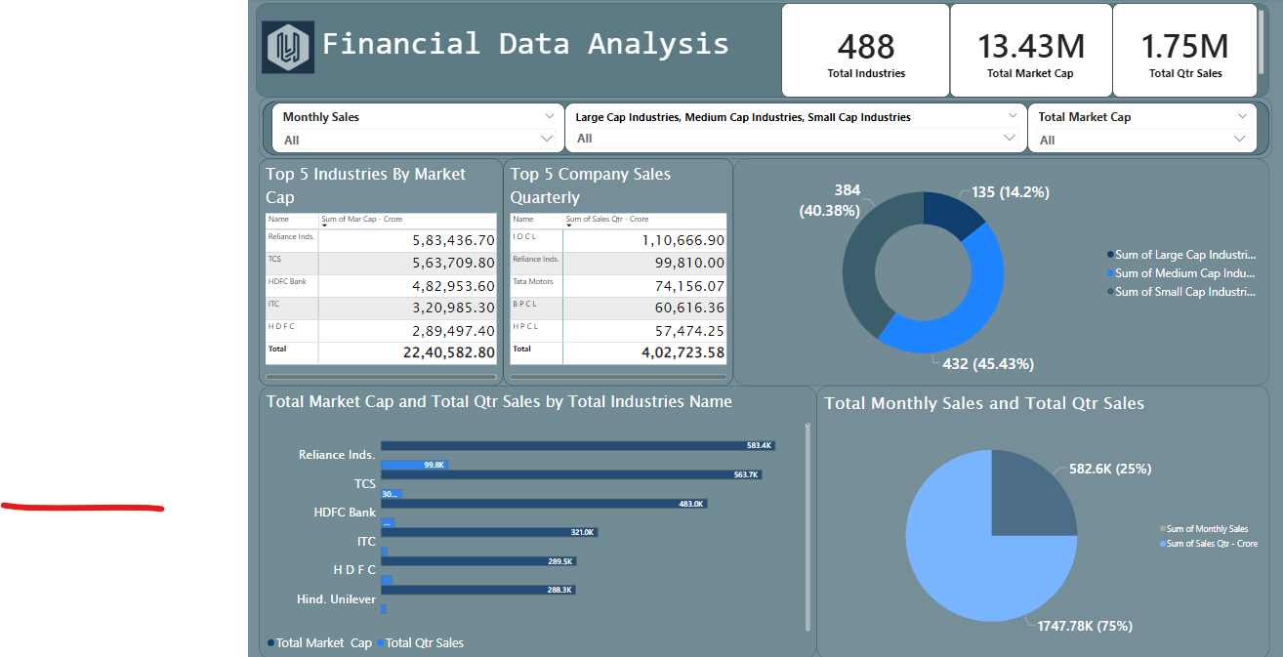
FINANCIAL DATA ANALYSIS DASHBOARD

Slide 7
THANK YOU

